Slide 1
CS6370 - Natural Language Processing
Project
Team-13
Abhishek Kumar (CS21M002)
Ganesh Jatavath (CS21M019)
Mohammed Safi Ur Rahman Khan (CS21M035)

Slide 2
Improvements on the Vector Space Model

Slide 3
Previous Work Done
Preprocessing the Documents and Queries
Sentence Segmentation
Word Tokenization
Inflection Reduction - Lemmatization
Stop Word Removal
Building Index using Vector Space Model
Ranking Documents based on this Index
Evaluation of the system on the queries

Slide 4
Shortcomings in Previous method
Fails to take the order of words into account
Assumes an orthogonal relationship between words
Words in the query must precisely match the words in the documents.
Never considers the semantic closeness and similarity of words (i.e., does blind matching)
Very computationally expensive
Theoretically assumes that terms are statistically independent.

Slide 5
Our Hypothesis
If we observe, a lot of limitations of the vector space model are revolving around the fact that this model fails to take into account the semantic relationship of the words (i.e., assuming orthogonality between words).
Our hypothesis is that we may be able to improve the performance of our search engine by removing the previous orthogonal assumption of words and modeling relationships between words and also by considering the context of the words (i.e., the distributional hypothesis which states that words that are used and occur in the same contexts tend to purport similar meanings)

Slide 6
Stuff tried out
Latent Semantic Analysis
Various Vectorizing techniques:
Bag Of Words (BOW)
TF-IDF
Word2Vec
Pretrained
Trained on Cranfield
Explicit Semantic Analysis

Slide 7
WHY LSA?
LSA assumes that words that are close in meaning will occur in similar pieces of text (i.e., distributional hypothesis).
It gives information beyond lexical levels, revealing hidden (latent) semantic relationships between the elements of interest.

Slide 8
WHY Different Vectorizers?
To capture some form of similarity between different words.
Three vectorization techniques
Bag of Words
Term frequency Inverse Document Frequency
Word2Vec.

Slide 9
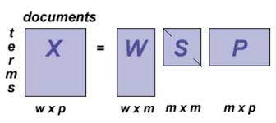
Singular Value Decomposition(SVD)
singular value decomposition (SVD) is used to reduce the number of rows while preserving the similarity structure among columns.
Where w= no of terms, p = no. of documents,

Slide 10
Various Vectorizing Techniques
Word vectorization is a methodology in NLP to map words or phrases from vocabulary to a corresponding vector of real numbers which used to find word predictions, word similarities/semantics.
We have tried
Tf-Idf
BOW
Word2Vec
Tf-Idf and BOW are semantic agnostic methods whereas Word2Vec hopes to capture some semantic characteristic of words by looking at its context.

Slide 11
Word2Vec
Word embeddings captures semantic and syntactic relationships between words and also the context of words in a document.
Word2vec model takes input as a large size of corpus and produces output to vector space.
Each word vector will be placed on this vector space. In vector space words that share context commonly in a corpus are closer to each other
the modern techniques use a neural network architecture to train complex data models and outperforms for huge datasets
We tried two methods:
Pretrained glove vectors
Training Word2Vec on Cranfield.

Slide 12
Pre-trained Word2Vec
Here download pre-trained Word2Vec and got GloVe vector
Then for each sentence , get document terms matrix
Using this, we build index for computing similarity matrix value
Then evaluate

Slide 13
Training Word2Vec model on Cranfield Dataset
Here used Cranfield dataset
Using this , we compute document term matrix
Then build index for computing similarity matrix
Then evaluate

Slide 14
ESA
Here we use the massive open source data present freely on the web in our case, Wikipedia.
Representing texts as a weighted mixture of a predetermined set of natural concepts, which are defined by humans themselves.
Meaning of texts in a high-dimensional space of concepts derived from Wikipedia.
Keeping in mind computational issues, we restricted ourselves to titles only.
Used the pymediawiki library for fetching various articles.

Slide 15
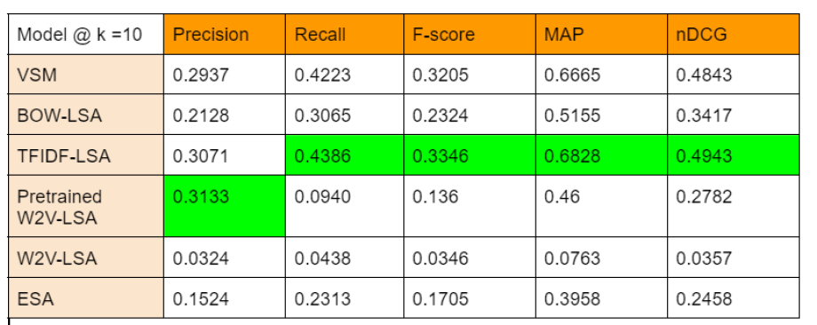
Results

